Slide 1
Cybersecurity of Medical Devices
Copyright
Christopher Kersbergen, JD
October 14, 2016

Slide 2
What is the problem?
2008 – Pacemaker hack
2011 – Insulin Pump hack
2013 – Discovery of a wide range of vulnerabilities: surgical and anesthesia devices, ventilators, infusion pumps, defibrillators, patient monitors, laboratory equipment
2015 - Hospira Symbiq Infusion System vulnerabilities
2016 – Vulnerabilities reported in St Jude Medical manufactured pacemakers
2016 – Johnson & Johnson alerts users of cybersecurity vulnerability in insulin pumps.
Copyright

Slide 3
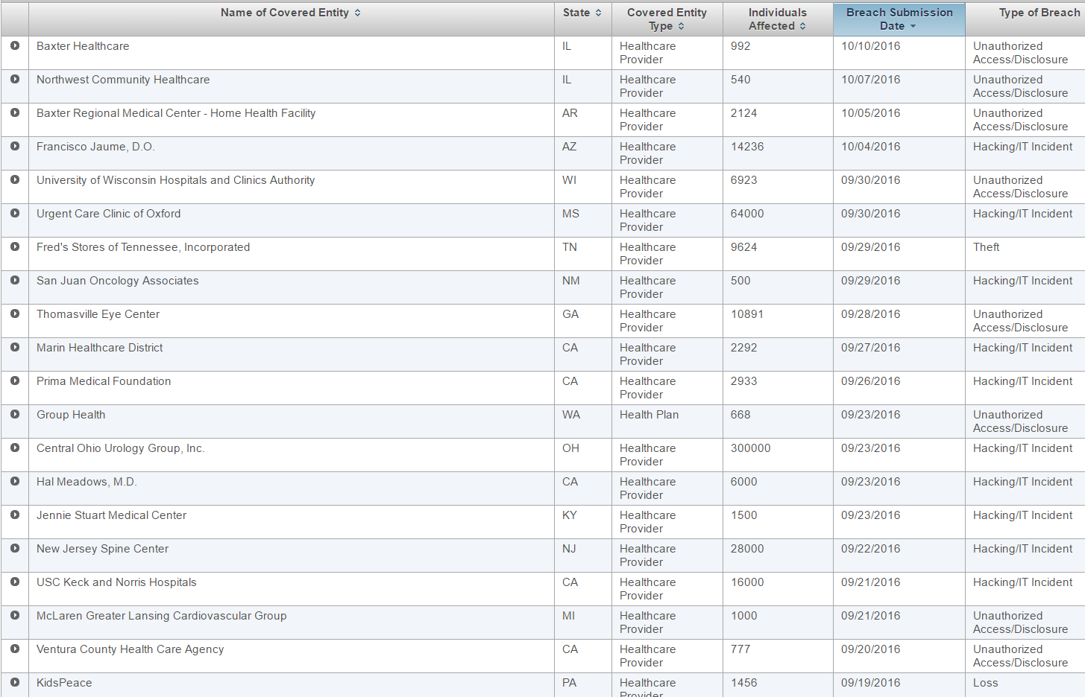
Copyright

Slide 4
Why are medical devices being attacked?
Enormous profit from stealing patient health information
No ability to scan for viruses and malware
Unsecured connections
Hardcoded passwords
Outdated operating systems
Copyright

Slide 5
How is cybersecurity of medical devices being addressed?
Food and Drug Administration Guidance
Shared Responsibility
Risk Management Programs
Routine Updates and Patches
Essential Clinical Performance
Controlled and Uncontrolled Risks
Information Sharing and Analysis Organizations (ISAO)
Copyright

Slide 6
Essential Clinical Performance
Manufacturer defined
Uncontrolled Risk = Serious Injury or Death
Controlled Risk = No Possibility of Injury or Death due to Vulnerability
Copyright

Slide 7
Information Sharing and Analysis Organizations (ISAO)
Marketplace for Information with all Stakeholders
Shared Vulnerabilities by All Stakeholders
Incentives for Joining
Copyright

Slide 8
Where is there room for Improvement?
Patient Privacy Issues Not Addressed
Physical Safety
Information Safety
ISAOs poorly defined
Inherent Risks with ISAOs
Opportunists Have Access to Vulnerability Information
Copyright

Slide 9
Conclusion
Requirements, not Just Recommendations
Copyright

